Slide 1


Paul Oxley
11th May 2025

Slide 2

Outline
Executive Summary
Introduction
Methodology
Results
Conclusion
Appendix

Slide 3
Executive Summary
Summary of methodologies
Data Collection: Web scraping
Data Wrangling: Cleaned, merged tables; etc
EDA: Plotted trends in payload, orbit, and success rates.
SQL: Queried launch success, payload totals, booster performance.
Interactive Analytics: Built Folium maps and Plotly Dash dashboard.
Predictive Modeling: Trained and tuned models (RF, SVM, KNN); selected best.
Summary of all results
EDA: Orbit and payload impact success; launch performance improves over time.
SQL: Identified top sites, boosters, and payload profiles.
Folium: Visualized global launch sites and landing outcomes.
Dash: Enabled real-time analysis by site and payload.
Best Model: Decision tree

Slide 4
Introduction
Project background and context
SpaceX has developed new ways to launch new rockets.
Predicting whether the first stage will land successfully is critical to understanding potential cost savings and launch reliability.
The project uses SpaceX launch data collected via web scraping and API to analyze launch patterns and build predictive models.
Problems you want to find answers
Can we predict whether a Falcon 9 first stage will successfully land
What features (like payload mass, booster version, or orbit type) have the strongest influence on landing success?
Which launch sites and booster versions are most reliable?

Slide 5

Section 1

Slide 6
Methodology
Executive Summary
Data collection methodology:
Collected launch data via web scraping
Perform data wrangling
Cleaned, merged, and transformed data
Perform exploratory data analysis (EDA) using visualization and SQL
Perform interactive visual analytics using Folium and Plotly Dash
Perform predictive analysis using classification models
Used GridSearchCV and accuracy metrics to select best model.

Slide 7
Data Collection
Describe how data sets were collected.
Falcon 9 launch history was collected by scraping structured HTML tables from Wikipedia.
Used requests and BeautifulSoup to extract and parse mission data, including launch date, payload, orbit, and mission outcome.
You need to present your data collection process use key phrases and flowcharts
[Wikipedia Page: Falcon 9 Launches]
↓
[requests.get() + BeautifulSoup]
↓
[Extract HTML Tables]
↓
[Convert to pandas DataFrame]
↓
[Clean & Format Columns]
↓
[Saved Data for EDA and Modeling]

Slide 8
Data Collection – SpaceX API
Present your data collection with SpaceX REST calls using key phrases and flowcharts
Add the GitHub URL of the completed SpaceX API calls notebook (must include completed code cell and outcome cell), as an external reference and peer-review purpose PauloLee77/Capstone
[Wikipedia Page URL]
↓
requests.get()
↓
BeautifulSoup parses HTML
↓
pd.read_html() extracts tables
↓
DataFrame created for analysis
our flowchart of SpaceX API calls here

Slide 9
Data Collection - Scraping
Present your web scraping process using key phrases and flowcharts
Add the GitHub URL of the completed web scraping notebook, as an external reference and peer-review purpose
[Wikipedia Launch History URL]
↓
requests.get(url)
↓
BeautifulSoup parses HTML
↓
pandas.read_html() extracts tables
↓
Clean and structure DataFrame
↓
Merge relevant tables for modeling

Slide 10
Data Wrangling
Describe how data were processed
Cleaned raw launch data by dropping irrelevant columns and handling missing values.
Standardized outcome descriptions by converting categorical values like "True ASDS", "False RTLS", etc., into a unified binary label for modeling.
Created a new binary target column:1 = Successful landing, 0 = Unsuccessful landing
You need to present your data wrangling process using key phrases and flowcharts
Add the GitHub URL of your completed data wrangling related notebooks, as an external reference and peer-review purpose PauloLee77/Capstone
[Raw Launch DataFrame]
↓
Drop Irrelevant Columns / Handle Nulls
↓
Standardize landing_outcome values
↓
Map Success to 1, Failure to 0
↓
[Final Cleaned DataFrame for Modeling]

Slide 11
EDA with Data Visualization
Summarize what charts were plotted and why you used those charts
Add the GitHub URL of your completed EDA with data visualization notebook, as an external reference and peer-review purpose
Visualised many different key points of the data, including pay load versus flight number success rate and yearly trend

Slide 12
EDA with SQL
Using bullet point format, summarize the SQL queries you performed
Loaded cleaned launch data into a Db2 database for SQL-based analysis and visualization.
Executed SQL queries to answer business questions such as identifying launch sites, calculating payload totals, and measuring success rates of alnding
Add the GitHub URL of your completed EDA with SQL notebook, as an external reference and peer-review purpose
PauloLee77/Capstone

Slide 13
Build an Interactive Map with Folium
Summarize what map objects such as markers, circles, lines, etc. you created and added to a folium map. Explain why you added those objects
Folium maps were produced to show launch sites and key characteristics like how close they were to rail, road and coast. This was to show the best location for the launch sites
Add the GitHub URL of your completed interactive map with Folium map, as an external reference and peer-review purpose

Slide 14
Build a Dashboard with Plotly Dash
Summarize what plots/graphs and interactions you have added to a dashboard
Dropdown Component (Task 1): Allows users to choose either "All Sites" or a specific launch site. Used to trigger updates to both the pie chart and scatter plot.
Pie Chart of Launch Outcomes (Task 2):Dynamically updates based on launch site selection from the dropdown menu. Displays either total success counts across all sites or success/failure distribution for the selected site
Range Slider Component (Task 3): Enables users to select a payload mass range. Helps in focusing the scatter plot on specific payload sizes.
Plot of Payload vs. Launch Outcome (Task 4):Plots payload mass against launch success (0 or 1), colored by booster version category. Filters dynamically based on payload mass range from the slider and selected launch site from the dropdown.
Explain why you added those plots and interactions
To give users interactive control over the analysis of launch outcomes. The pie chart helps quickly understand success ratios by site. The scatter plot reveals relationships between payload mass and mission outcome, highlighting which booster configurations succeed with different payload sizes. Dropdown and slider allow real-time filtering, improving data accessibility and visual storytelling without code.

Slide 15
Predictive Analysis (Classification)
Summarize how you built, evaluated, improved, and found the best performing classification model
Built a machine learning pipeline using data wrangled from SpaceX launch history to predict whether the first stage will land successfully.
Features included: payload mass, orbit type, launch site, and booster version.
StandardScaler for numerical features.
Trained and evaluated multiple classification models:
Logistic Regression
Support Vector Machine (SVM)
K-Nearest Neighbors (KNN)
Random Forest Classifier
Used GridSearchCV for hyperparameter tuning and cross-validation for evaluation consistency.
Decision Tree was best performing
You need present your model development process using key phrases and flowchart
Add the GitHub URL of your completed predictive analysis lab, as an external reference and peer-review purpose PauloLee77/Capstone
[Cleaned Launch Data]
↓
[Split into Train/Test Sets]
↓
[Train Models: LR, SVM, KNN, DT]
↓
[Evaluate Accuracy & Confusion Matrix]
↓
[GridSearchCV for Best Hyperparameters]
↓
[Select Best Model – Random Forest]

Slide 16
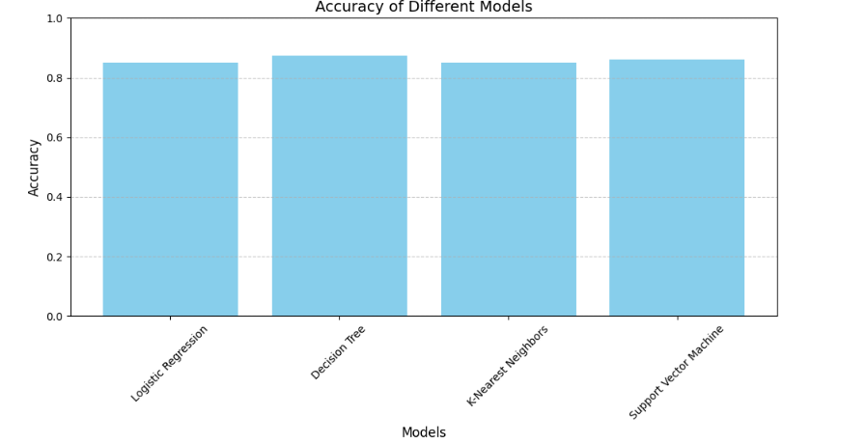
Results
Exploratory data analysis results
Interactive analytics demo in screenshots
Predictive analysis results

Slide 17

Section 2

Slide 18
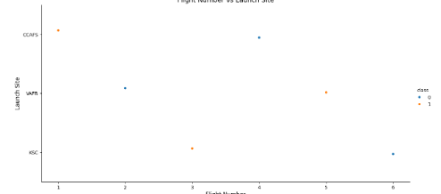
Flight Number vs. Launch Site
Show a scatter plot of Flight Number vs. Launch Site
Show the screenshot of the scatter plot with explanations
There appears to be a rotation between launch sites

Slide 19
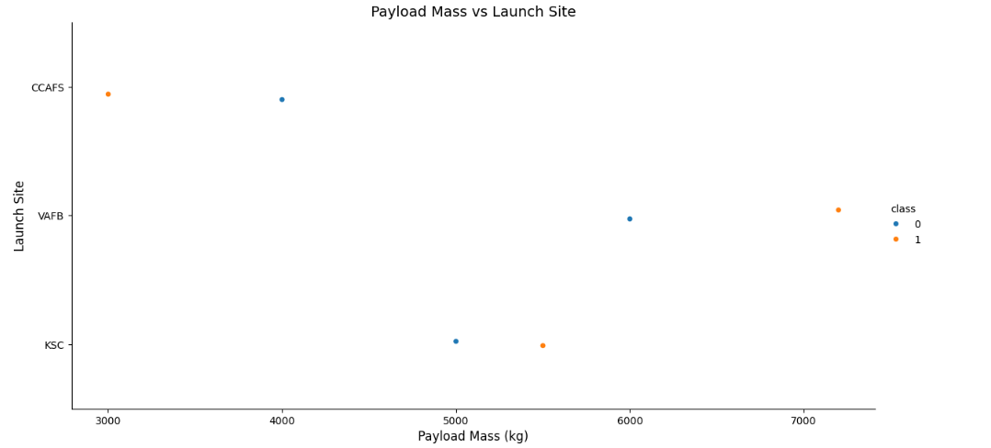
Payload vs. Launch Site
Show a scatter plot of Payload vs. Launch Site
Show the screenshot of the scatter plot with explanations
Launch site uses the highest payload and CCAFS the lowest payload

Slide 20
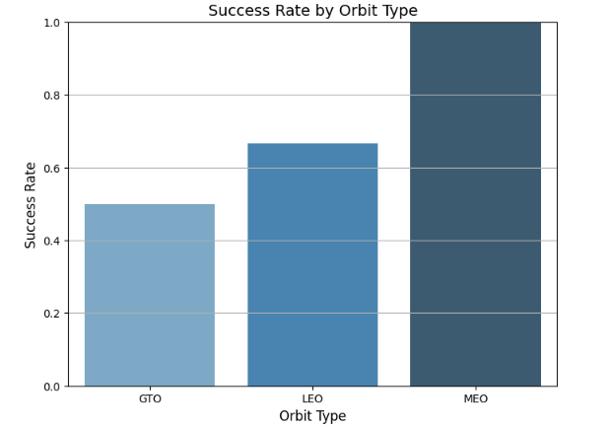
Success Rate vs. Orbit Type
Show a bar chart for the success rate of each orbit type
Show the screenshot of the scatter plot with explanations
MEO has a 100% success rate and hence is the best Orbit type

Slide 21
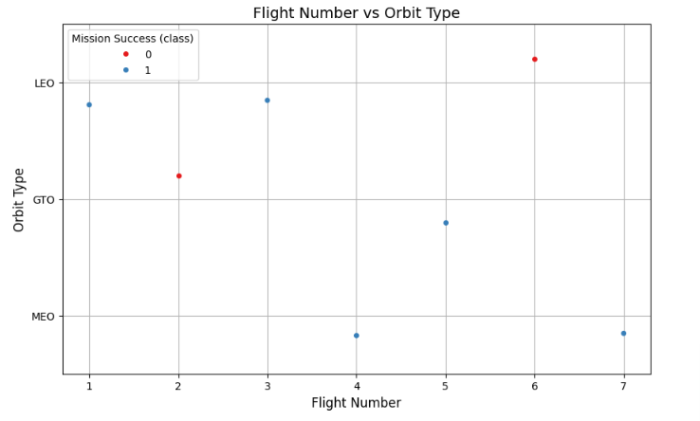
Flight Number vs. Orbit Type
Show a scatter point of Flight number vs. Orbit type
Show the screenshot of the scatter plot with explanations
LEO success seems related to the number of flights. GTO orbit, there appears to be no relationship between flight number and success.

Slide 22
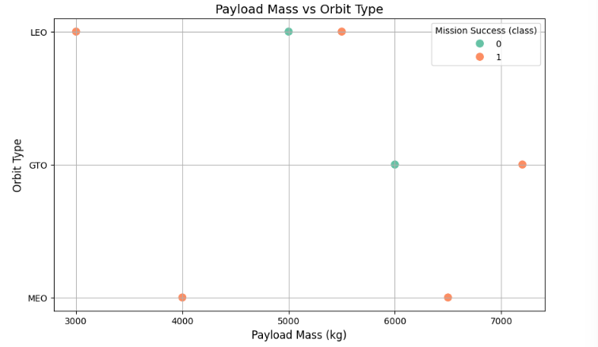
Payload vs. Orbit Type
Show a scatter point of payload vs. orbit type
Show the screenshot of the scatter plot with explanations
It is hard to determine a pattern as there are both success and failure at low and high payload

Slide 23
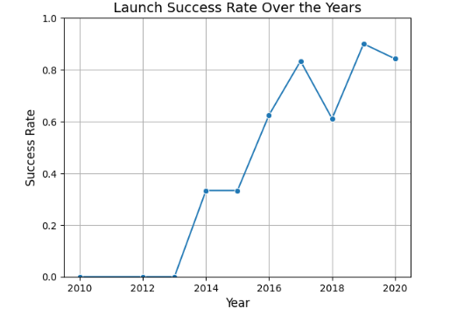
Launch Success Yearly Trend
Show a line chart of yearly average success rate
Show the screenshot of the scatter plot with explanations
Success rate has gradually increased over time

Slide 24
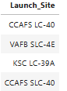
All Launch Site Names
Find the names of the unique launch sites
Present your query result with a short explanation here
Below are the 4 launch sites

Slide 25
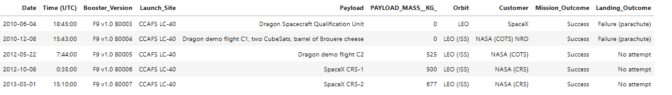
Launch Site Names Begin with 'CCA'
Find 5 records where launch sites begin with `CCA`
Present your query result with a short explanation here
Below are 5 records with launch sites starting with ‘CCA’

Slide 26
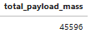
Total Payload Mass
Calculate the total payload carried by boosters from NASA
Present your query result with a short explanation here
The average payload mass is about 46,000kg

Slide 27
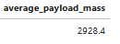
Average Payload Mass by F9 v1.1
Calculate the average payload mass carried by booster version F9 v1.1
Present your query result with a short explanation here
The average payload mass is just under 3000 kg

Slide 28
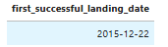
First Successful Ground Landing Date
Find the dates of the first successful landing outcome on ground pad
Present your query result with a short explanation here
The first successful landing date was in 2015

Slide 29
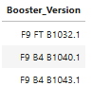
Successful Drone Ship Landing with Payload between 4000 and 6000
List the names of boosters which have successfully landed on drone ship and had payload mass greater than 4000 but less than 6000
Present your query result with a short explanation here
Ther have been 3 launches that have successfully landed on a drone ship with payloads between 44000 and 6000

Slide 30
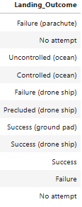
Total Number of Successful and Failure Mission Outcomes
Calculate the total number of successful and failure mission outcomes
Present your query result with a short explanation here
There have been a number of successful and failure landings using different landing equipment

Slide 31
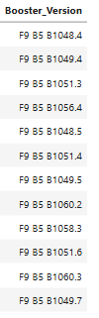
Boosters Carried Maximum Payload
List the names of the booster which have carried the maximum payload mass
Present your query result with a short explanation here
It appears that the F9 is the only booster to carry the maximum payload. There have been 12 launches so far with the maximum payload

Slide 32
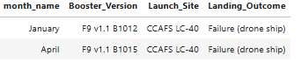
2015 Launch Records
List the failed landingoutcomes in drone ship, their booster versions, and launch site names for in year 2015
Present your query result with a short explanation here
There were 2 failed landings in 2015, both using a drone ship

Slide 33
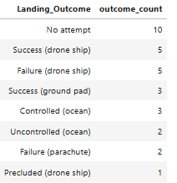
Rank Landing Outcomes Between 2010-06-04 and 2017-03-20
Rank the count of landing outcomes (such as Failure (drone ship) or Success (ground pad)) between the date 2010-06-04 and 2017-03-20, in descending order
Present your query result with a short explanation here
The most likely outcome is that no attempt. Next is using a drone ship where 5 are successful and 5 failed

Slide 34

Section 3

Slide 35
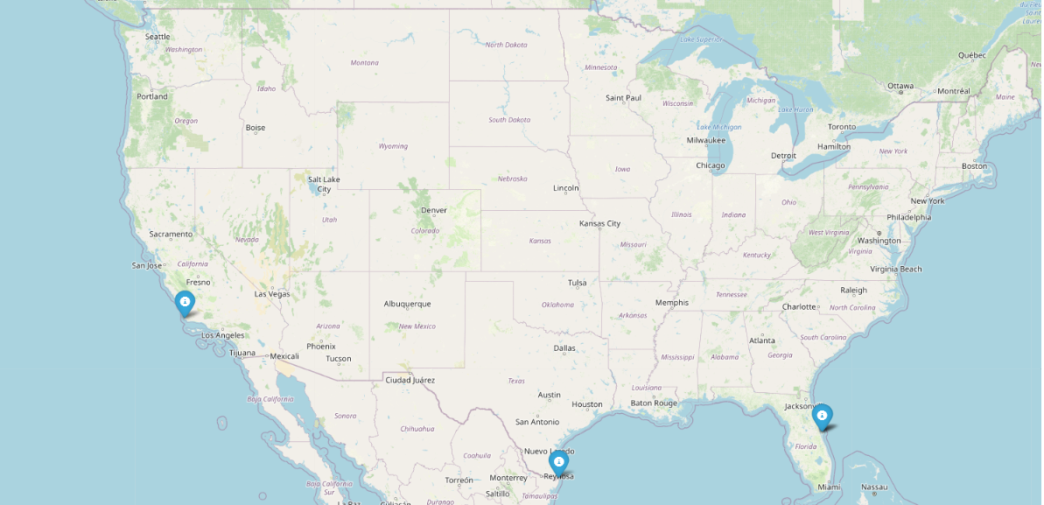
Launch Site locations
Launch sites are in southern USA on the coasts

Slide 36
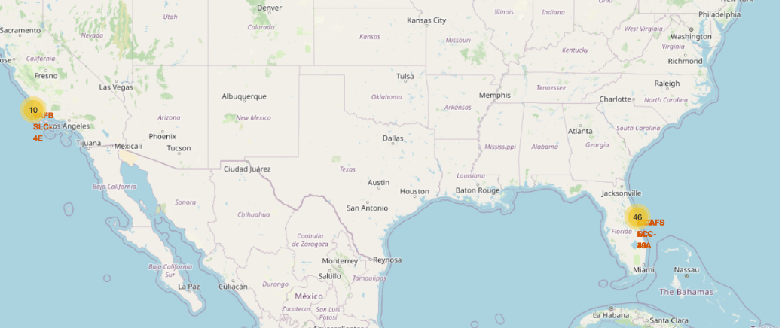
Launch outcomes
The map shows there have been a number of successful and failure launches at each location

Slide 37
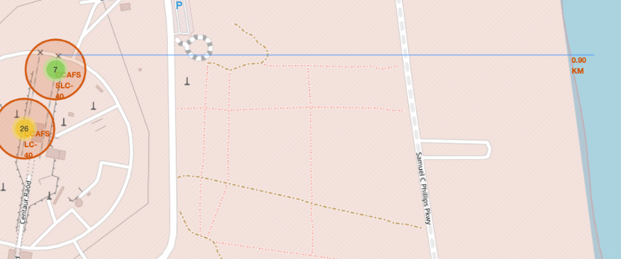
Launch Site locations
As shown below launch sites are served by railways and roads and are close to the coast

Slide 38

Section 4

Slide 39
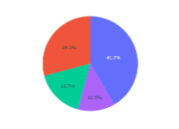
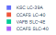
SpaceX Launch Records Dashboards
Show the screenshot of launch success count for all sites, in a piechart
Explain the important elements and findings on the screenshot
The most successful launches are the CCAFS SLC-40

Slide 40
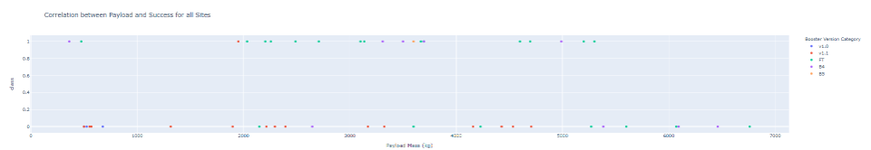
Correlation between Payload and Success for all Sites
Show screenshots of Payload vs. Launch Outcome scatter plot for all sites, with different payload selected in the range slider
Explain the important elements and findings on the screenshot, such as which payload range or booster version have the largest success rate,
Most success payload range is generally between 2000 and 4000 range
FT has a large successful lanch

Slide 41

Section 5

Slide 42
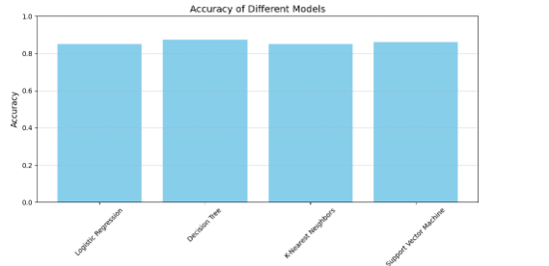
Classification Accuracy
Visualize the built model accuracy for all built classification models, in a bar chart
Decision tree has the highest classification accuracy

Slide 43
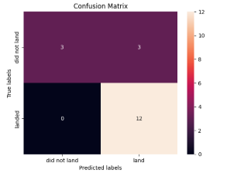
Confusion Matrix
Show the confusion matrix of the best performing model with an explanation

Slide 44
Conclusions
All methods have similar accuracy
Decision trees has that highest accuracy

Slide 45
Appendix
Include any relevant assets like Python code snippets, SQL queries, charts, Notebook outputs, or data sets that you may have created during this project

Slide 46


